Slide 1
FACIAL RECOGNITION AND DETECTION
RASPBERRY PI
Presented By
Boniface Dakey
Evans Acheampong
Edward Acquah
Eyram
Raphael Kuayi
Delchris Daniels
Prince Charles Oheneba Nkyi

Slide 2
What is a raspberry pi

Slide 3
What is facial recognition and detection ?
Face recognition is a computer application (biometric technology) that is capable of detecting, tracking, identifying or verifying human faces from an image or video captured using a digital camera.

Slide 4
components
Raspberry Pi Camera
Raspberry Pi 3 Model B Motherboard
3.5-inch Touch Display for Raspberry Pi
Micro Motion Sensor
Arduino Nano
5mm LED
Relay Module

Slide 5
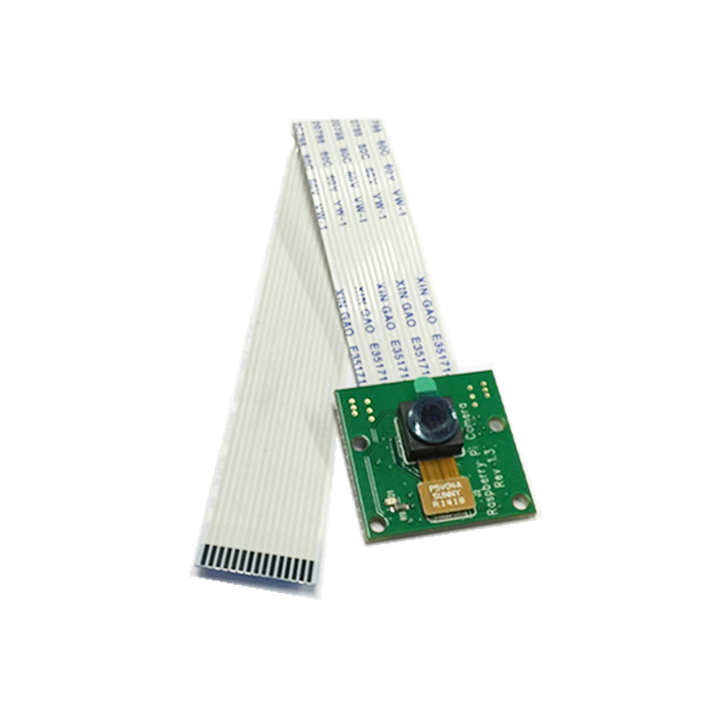
Raspberry pi camera
It has several applications including DSLR camera control, time-lapsing machine, security system and face recognition.

Slide 6
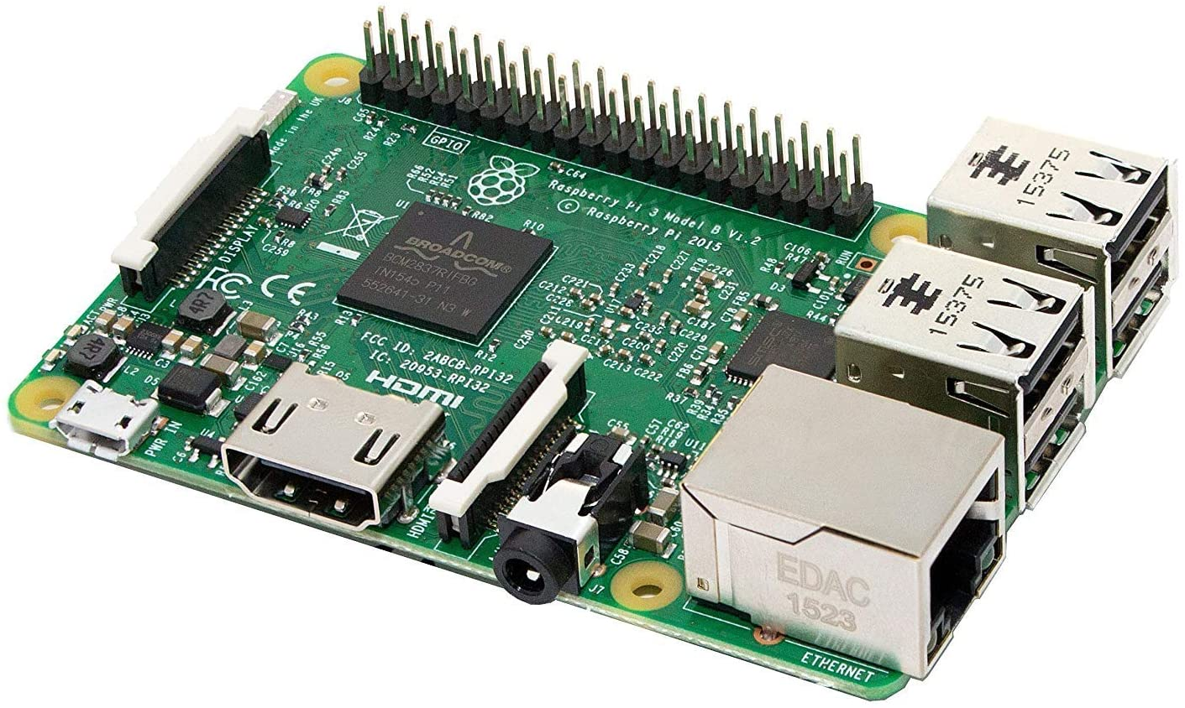
Raspberry pi 3 module b motherboard
A low cost, credit-card sized computer that plugs into a computer monitor or TV, and uses a standard keyboard and mouse. It is a device that enables people to explore computing and learn how to program in languages like Scratch and Python.

Slide 7
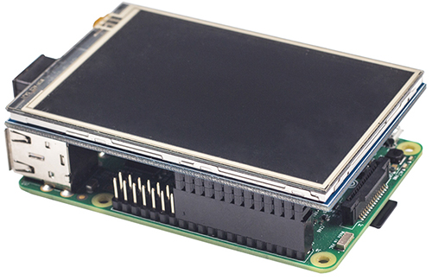
3.5-inch Touch Display for Raspberry Pi

Slide 8
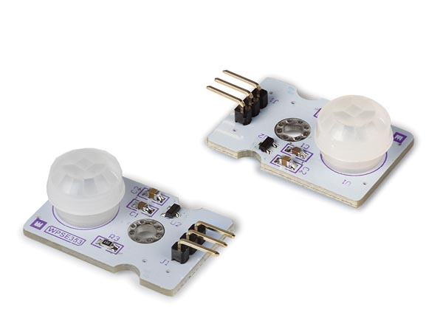
Micro motion sensor
A device that utilizes a sensor to detect nearby motion

Slide 9
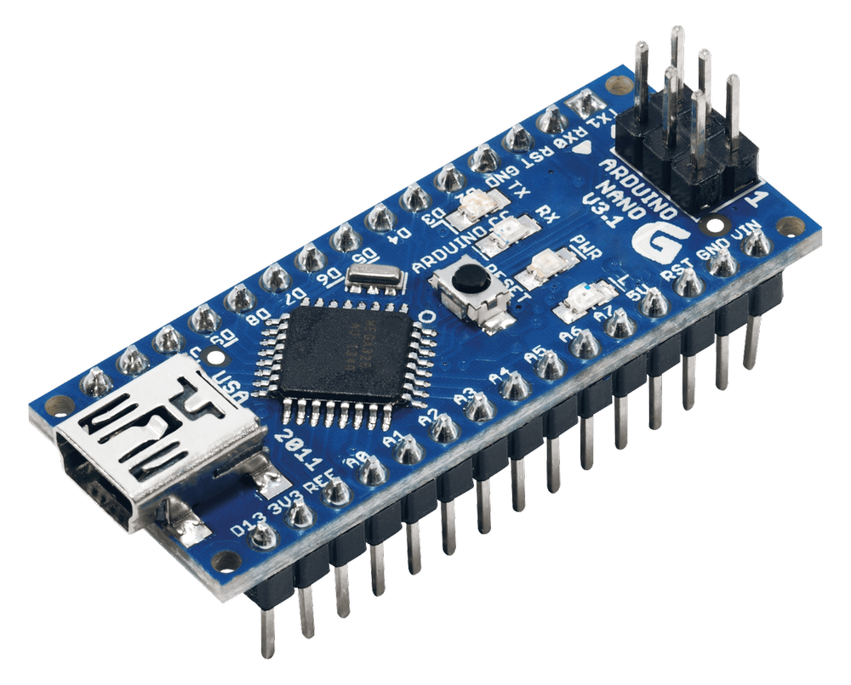
Arduino nano
A very small computer that can read input and transmit data through output devices. Smaller version of Arduino Uno.

Slide 10
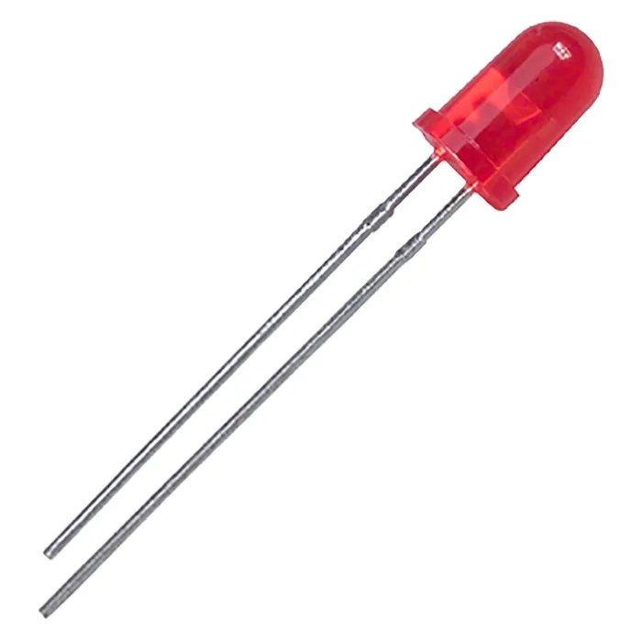
5mm led
A semiconductor light source that emits light when current passes through it.

Slide 11
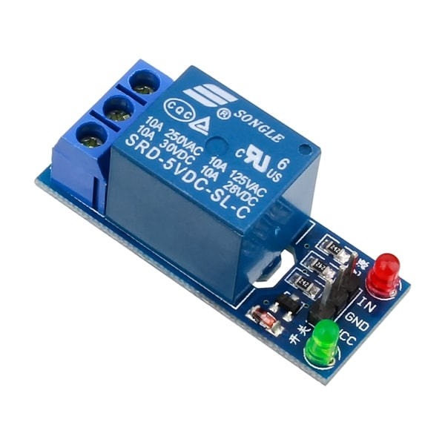
Relay module
A power relay module is an electrical switch that connects or disconnect two circuits.

Slide 12
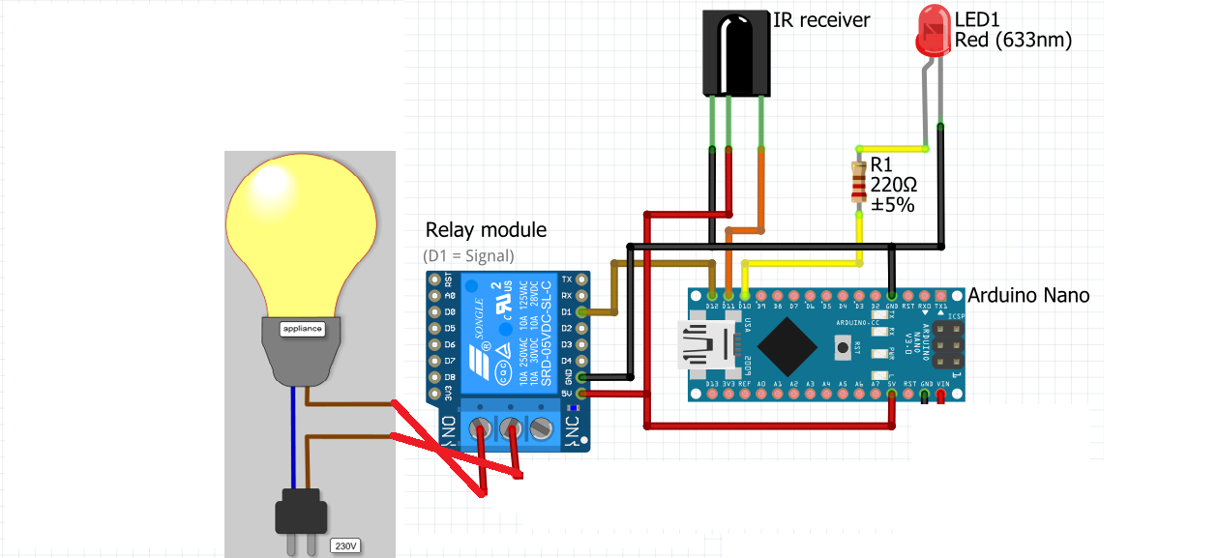
Arduino setup

Slide 13
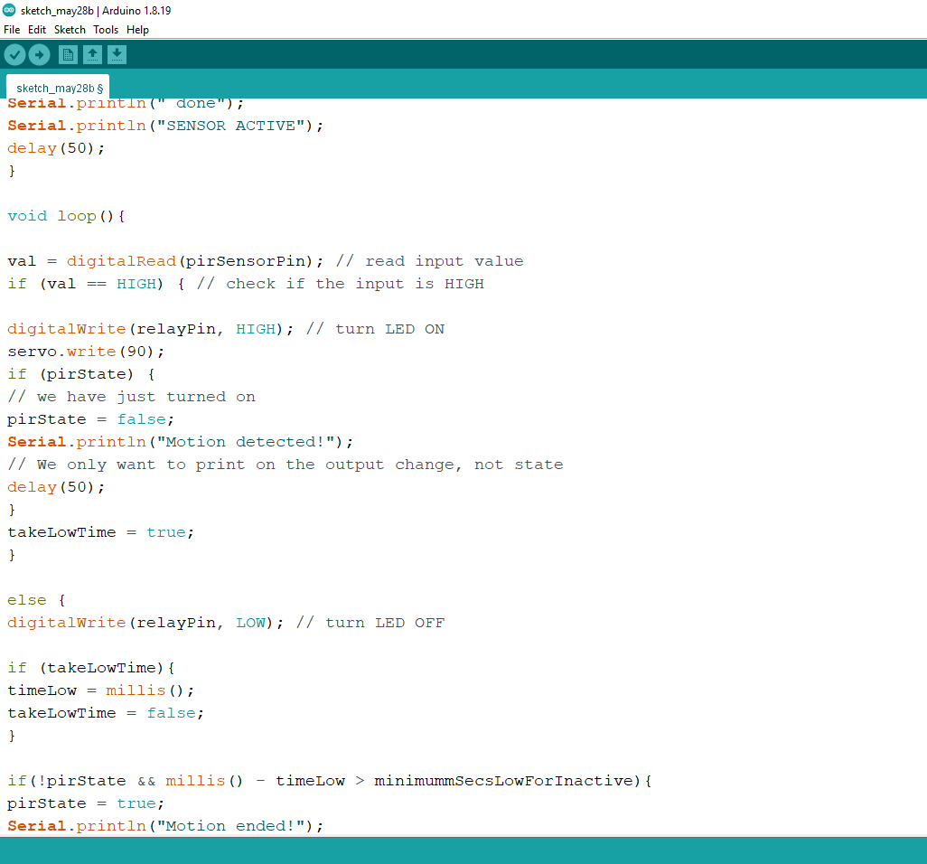
code

Slide 14
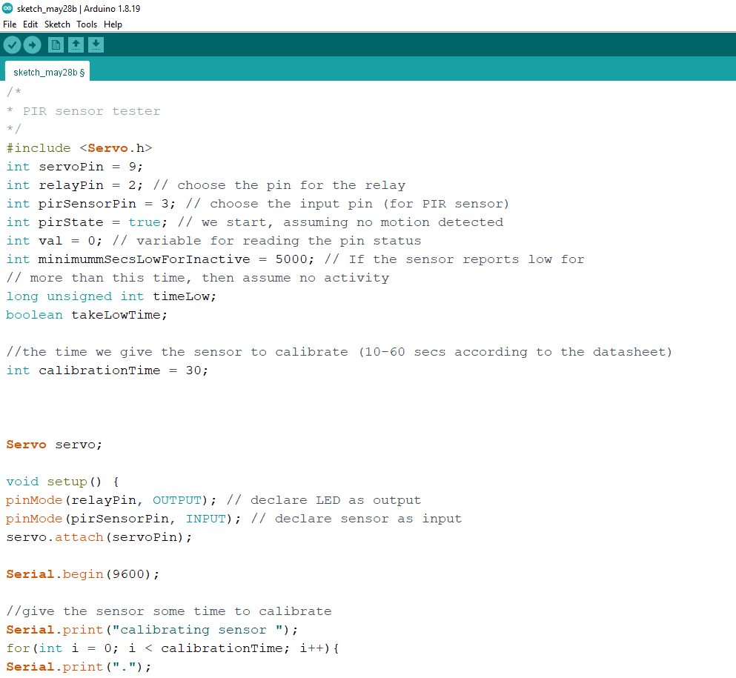
code

Slide 15
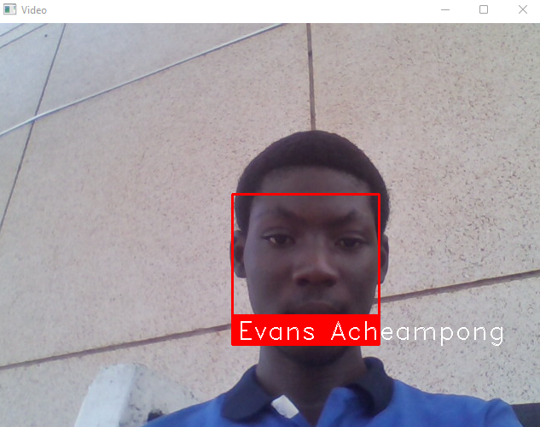
Face detection and recognition by raspberry pi

Slide 16
conclusion
In conclusion, in our research, after preprocessing the input face images using some advanced image processing techniques such as Contrast Adjustment through improving the lighting system, so as to have better image features and the same advanced image processing techniques will be applied to the training/template face images plus an image blending method to ensure high-quality training/template face images. Hence the raspberry pi camera successfully made out my face and name (Evans Acheampong) with the immense help of illumination emanating from the Arduino setup.

